Slide 1
NATIONAL UNIVERSITY OF HO CHI MINH CITY
UNIVERSITY OF INFORMATION TECHNOLOGY
Faculty of Networking and Communication
Thesis Report
STUDY MALICIOUS BEHAVIOR ANALYSIS METHODS
TO DETECT SECURITY RISKS ON WINDOWS
Tutor
PhD. Nguyễn Anh Tuấn
Student
Lê Thanh Bình
Châu Thiện Hưng

Slide 2
REPORT CONTENT
The Need of APTIDS
APTIDS Overview
Registry Monitor Module
Service Monitor Module
Sentry Forensic Module
Distributed Log Collector Hardware (DLCH)
Centralized Log Storage System (CLSS)
Demonstration

Slide 3
THE NEED OF APTIDS
APT trend from the Darkside
RECONNAISSANCE
INCURSION
DISCOVERY
CAPTURE
EXFILTRATION

Slide 4

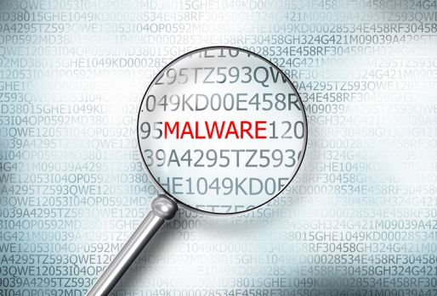
THE NEED OF APTIDS
APTIDS Abilitities
MONITORING ANALYZING

Slide 5
APTIDS OVERVIEW
APTIDS’s Modules
APTIDS
Registry Monitor
Services Monitor
Logging
DLCH
CLSS
Sentry Forensic

Slide 6
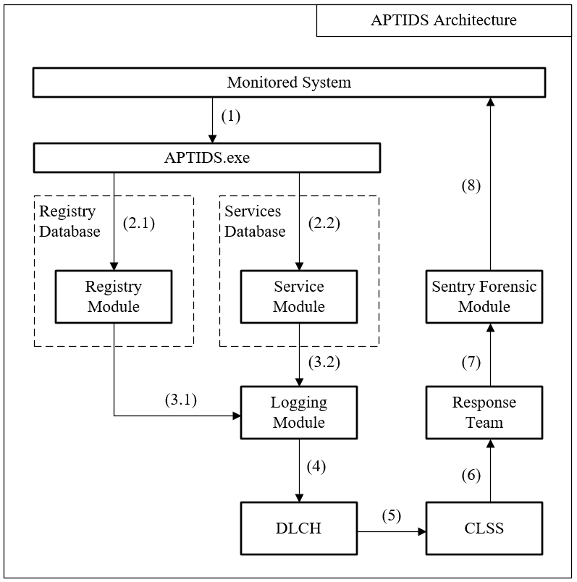
APTIDS OVERVIEW
APTIDS’s Overall Architecture
- Monitored System runs APTIDS.exe
- Monitor Registry and Services
- Log critical activities
- Send Log to Distributed Log Collector Hardware
- Send Log to Centralized Log Storage System
- Response Team monitors the log information
- Response Team uses Sentry Forensic to identify the threats
- Sentry Forensic is run in the compromised host

Slide 7


REGISTRY MONITOR MODULE
The need of Registry Monitor Module
Malwares sometimes hide in Registry for persistent run at System startup.
Malicious Registry Entry’s value also indicate where the malicious file is.
Malwares add registry Values and Subkeys, rarely modify them or delete them.

Slide 8
REGISTRY MONITOR MODULE
Overall Architecture
Logging
Write log to file
Configuration
File
Keys to be monitored
Identify Inserted
Values
Identify Modified
Value’s name
Subkeys
Subkey’s name
Send log to DLCH

Slide 9
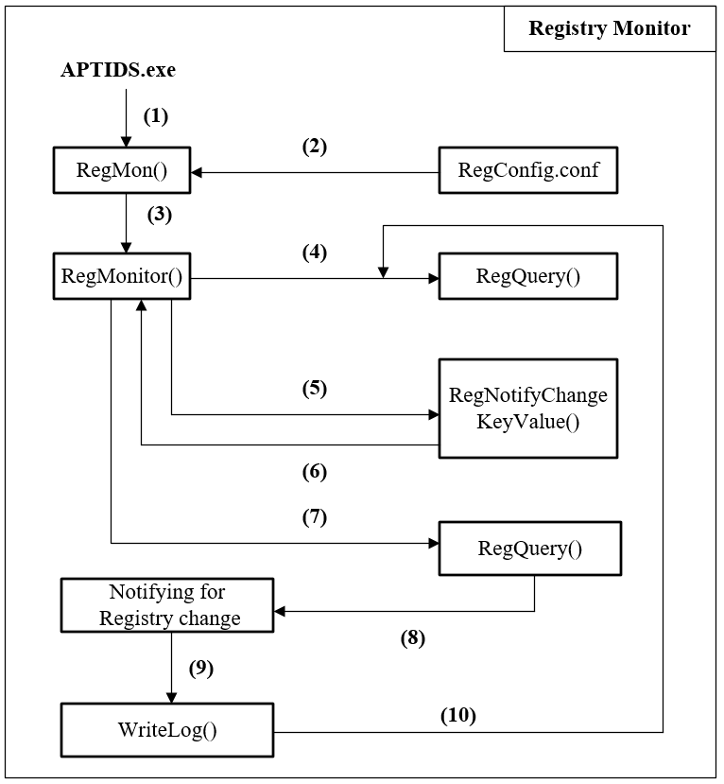
REGISTRY MONITOR MODULE
APTIDS calls RegMon
RegMon reads Configuration file for monitored keys
RegMon calls RegMonitor in a separated threads for each key.
RegMonitor calls RegQuery for getting the first snapshot
RegMonitor call RegNotifyChangeKeyValue
RegNotifyChangekeyValue notifies change and returns
RegMonitor calls RegQuery again to identify the change
RegQuery return the information
RegQuery calls WriteLog for writing log and send to DLCH
Return to step 4
Workflows and Implementation

Slide 10
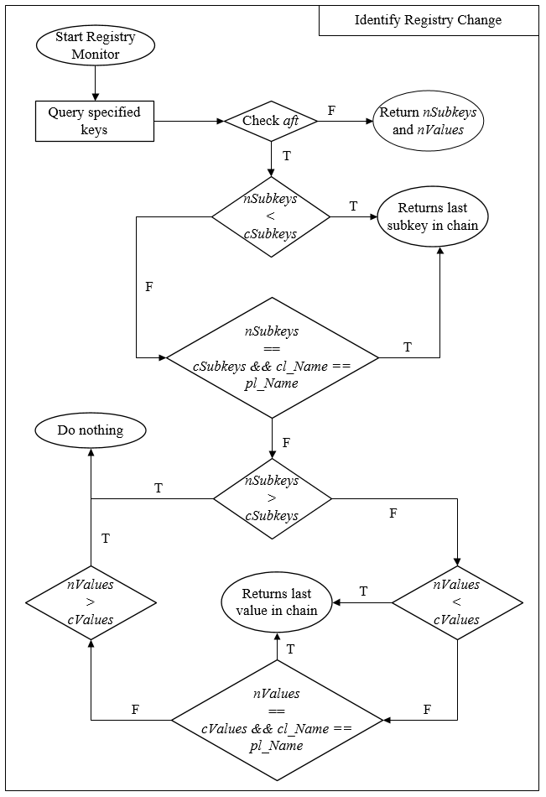
REGISTRY MONITOR MODULE
Logical Sequences

Slide 11



SERVICE MONITOR MODULE
The need of Service Monitor Module
Like Registry, Malware also creates persistent entry in Windows Service.
Auto start whether there is any user logged in.

Slide 12
SERVICE MONITOR MODULE
Overall Architecture
Monitoring Windows Services
Identify Created Service
Identify Deleted Service
Logging

Slide 13
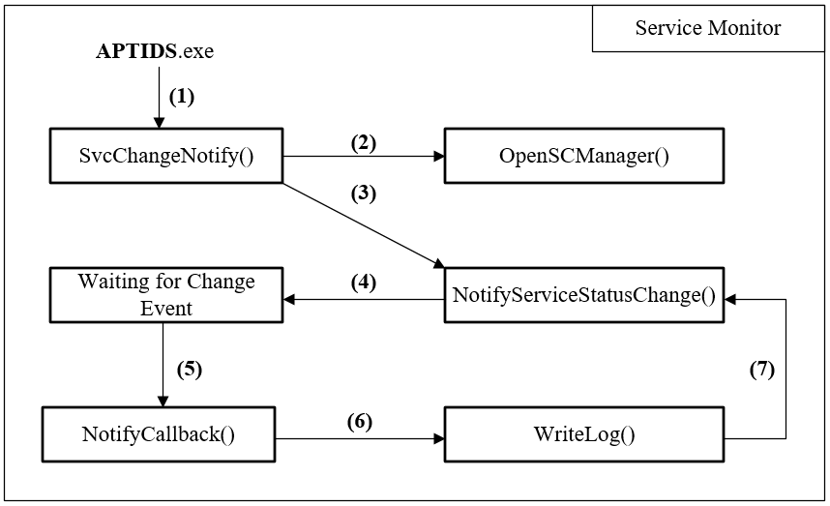
SERVICE MONITORING MODULE
APTIDS.exe calls SvcChangeNotify
SvcChangeNotify get an SCM handle from OpenSCManager
SvcChangenotify calls NotifyServiceStatusChange for capture event that modify SCM
NotifyServiceStatusChange waits for SCM event
In case there is any event happens, NotifyCallback is executed
NotifyCallback calls WriteLog for writing log and sending log to DLCH.
Workflows and Implementations

Slide 14
DISTRIBUTED LOG COLLECTOR HARDWARE
Overall Architecture
Communicates with APTIDS.exe
Receives
Log Data
Writes log to file
Sends log to CLSS

Slide 15
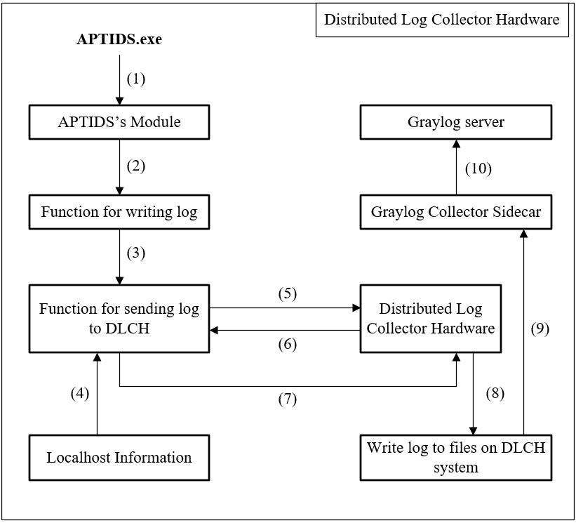
DISTRIBUTED LOG COLLECTOR HARDWARE
APTIDS.exe calls its modules
When captures an event, modules calls Writelog
WriteLog calls function to send log to DLCH
This function gets information about localsystem
Send that info to DLCH
DLCH sends back an available port
APTIDS Agent uses that port to communicate with DLCH
DLCH writes log data to log files
Waiting for Graylog Collector Sidecar to collect this log data
Graylog Collector Sidecar sends log to Graylog Server
Workflows and Implementations

Slide 16
CENTRALIZED LOG COLLECTOR HARDWARE
Overall Architecture
Storing Log Data
Displaying Log Data
Receiving Log Data

Slide 17
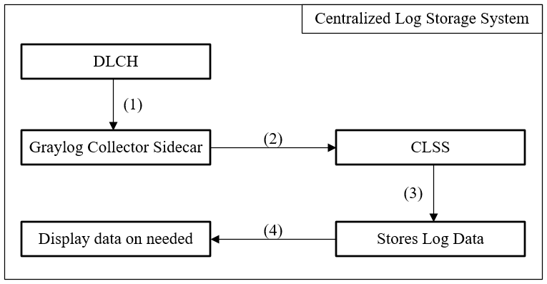
CENTRALIZED LOG COLLECTOR HARDWARE
Workflows and Implementations
Graylog Collector Sidecar collecting log from DLCH
Graylog Collector Sidecar sends log data to CLSS
CLSS stores Log Data using its database
CLSS display log information on needed

Slide 18
Sentry Forensic Module

Slide 19
DEMONSTRATION
APTIDS’s Demonstration

Slide 20
DEMONSTRATION
Sentry Demonstration

